Slide 1
How to work with your dev community + featuring the Windows Insider Program
28th May 15:00 - 15:20
In Person event

Slide 2

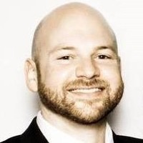
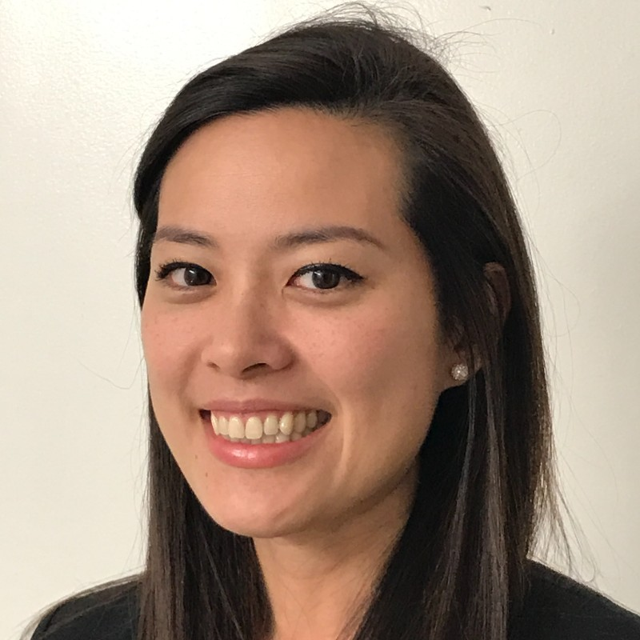
Microsoft Build: Student Developer Drop-In Day
How to work with your dev community + featuring the Windows Insider Program
Salman Chishti
Jason Howard
Susie Yang
Microsoft Azure & Windows Insider MVP
Sr. Program Manager
Sr. Product Marketing Manager

Slide 3

TIME FOR ANOTHER QUIZ

Slide 4















Slide 5
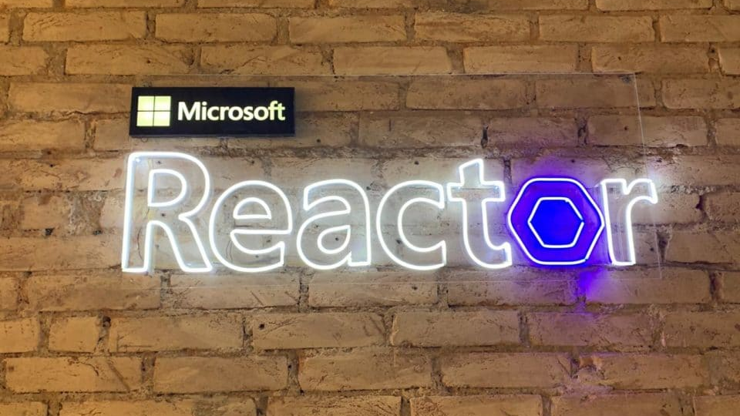
Partake in events
This Photo by Unknown Author is licensed under CC BY

Slide 6
Open source

Slide 7
Windows Insider Program

Slide 8
Provides early access to the next version of Windows before public release.
Windows Insiders run Windows Insider Preview Builds, then give feedback and engage directly with our engineers to help shape the future of Windows.
Select your content (Channel) and chart your course:
Dev Channel
Right for highly technical users.
The long lead work from our engineers with features and experiences that may never get released as we try out different concepts and get feedback.
There will be rough edges and some instability.
Beta Channel
Right for early adopters.
Previewing features & experiences that are closer to what we will ship to our general customers.
As the Dev and Beta Channels represent parallel development paths, there may be cases where features and experiences show up in the Beta Channel first.
Release Preview
Right for those who want stability and release validation.
Access and preview the upcoming release of Windows prior to it being release to general customers, with advanced quality updates and certain key features.
Dev Channel
Beta Channel
Release Preview Channel

Slide 9



Derive insights from customer feedback
Insights
Feedback
Customer Feedback Loop
Identify potential improvements
Product making
Tell our story to customers
Storytelling

Slide 10
WinUI 2 Gallery

Slide 11
Windows Insider Feature Demo

Slide 12




Partnership: Windows Insider Program x Microsoft Learn Student Ambassadors
An extended journey to empower Student Ambassadors to achieve more!
Student Ambassadors who join the
Windows Insider Program will have an opportunity to preview Windows and
enjoy benefits designed exclusively
for you.
Benefits exclusively for Student Ambassadors x Windows Insiders
Virtual meeting backgrounds
Special recognition badge in Windows Feedback Hub app
🦸🏻‍♂️
🦹🏻‍♀️
Empowered by Windows team
Nomination to WIMVP (Gold Student Ambassadors)

Slide 13

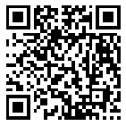




Windows Insider Program
Quick Access Guide
Find out the latest Insider builds --- aka.ms/WIPBlog (Windows Insider Blog)
See the release logs of Insider builds --- aka.ms/FlightHub (Flight Hub)
File your feedback on Windows ---aka.ms/FeedbackHub (Feedback Hub)
Windows technical documentation for developers –
aka.ms/InsiderDocs (Microsoft Docs WIP)
Download the latest ISO ---
aka.ms/WIPISO (WIP ISO Media)
Got question? Answers Forum (WIP)
aka.ms/FWIP
Join us!
aka.ms/JoinWIP
@windowsinsider
windowsinsider
@WindowsInsiderProgram
aka.ms/WIPYouTubeSub
Follow us!

Slide 14
Next steps
All the resources!
Microsoft-Build-Student-Developer-Drop-in-day Resources
Windows Insider Program
Insider.windows.com
Student Hub
https://aka.ms/learnstudent
Cloud Skills Challenge https://aka.ms/StudentDeveloperDayChallenge

Slide 15
My journey
Started coding because I found games limiting
School programming was limited
Content creation
University, president of Computer Science society in first year
Attended a bunch of Microsoft Events (including Windows Insider ones)
Tried to run Microsoft events
New university
Teaching coding through games
Cloud Solution Architect at Microsoft
Program Manager at Microsoft
Last exam May 2022
Microsoft Open Source
More open source
SWE, Data Analyst, HoloLens developer and worked for my university

Slide 16
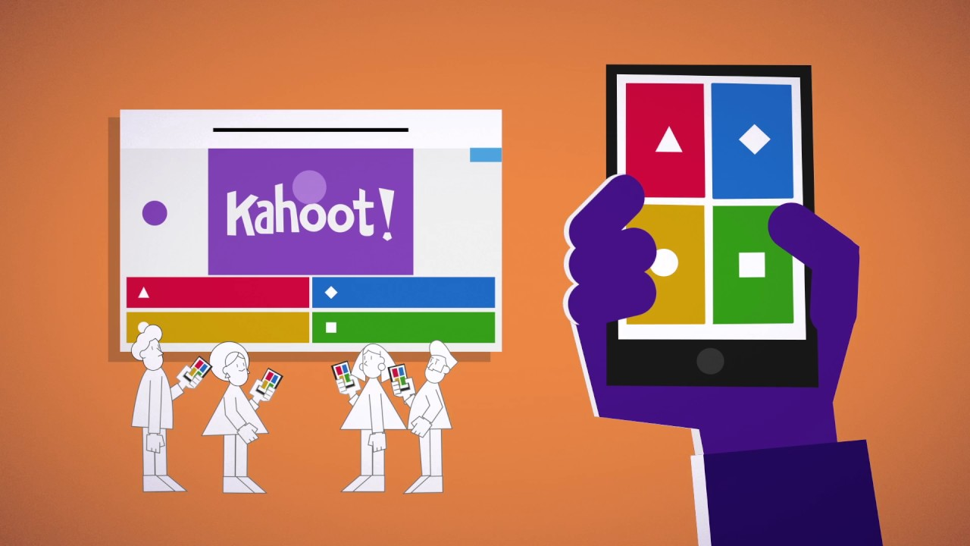
Quiz

Slide 17
Agenda Part 1
10:00 – 10:30
Welcome to the Student event - Speakers: Bruno Capuano and Salman Chishti
10:30 – 10:40
Getting Started with Azure for Student - Speaker: Bruno Capuano
10:40 – 10:50
Getting Started with Microsoft Learn and free student certifications Speaker: Gemma Robson
11:00 – 12:00
AI Gaming Challenge Speaker: Stephen Graham AI Gaming
12:00 – 12:40
Lunch & Networking
12:40 – 13:10
Power Platform Low Code No Code Development Speaker: Bruno Capuano
13:10 – 13:40
Career Festive – What roles are in Microsoft for interns and Grads Speaker: Gianluca Sanfilippo, Ethan Jones, Rosen Georgiev and Host Aurele Mes Boaye
13:40 – 14:20
Introduction to programming hello world in 3 languages Speaker: Bruno Capuano

Slide 18
Agenda Part 2
14:20 – 14:30
Rock your Profile and Resume Builder with LinkedIn​ Speaker: Gianluca Sanfilippo​
14:30 – 14:40
Microsoft Certifications and the road to a tech job​ Speaker Rosen Georgiev​
14:40 – 14:50
Ambassadors showcase - Standing out from the crowd what the ambassadors badge did for me.​ Speaker Salman Chishti​
15:00 – 15:20
Ambassadors showcase - Ambassadors in the community – how to work with your dev community​ Speaker Salman Chishti and Susie Yang​
15:20 – 15:50
Gaming and Azure - Introduction to ID@Azure a new program to help you learn and make successful games using cloud services​ Speaker Bruno Capuano​
15:50 – 16:20
MVP Showcase - Home Automation with the Azure Percept​ Speaker Peter Gallagher​
16:30 – 17:00
Getting Started with Azure Static Web Apps to Host your Resume​ Speaker Bruno Capuano​
17:00 – 18:00
BUILD AI Gaming Challenge Final​ Speakers: Stephen Graham/ Bruno Capuano )​
18:00
Close and Celebration.​ Speakers: Bruno Capuano Salman Chishti

